Slide 1

Rewards Program API
A central location for users to store information about their rewards points balance for multiple rewards programs.
Lauren Macdonald

Slide 2





Slide 3
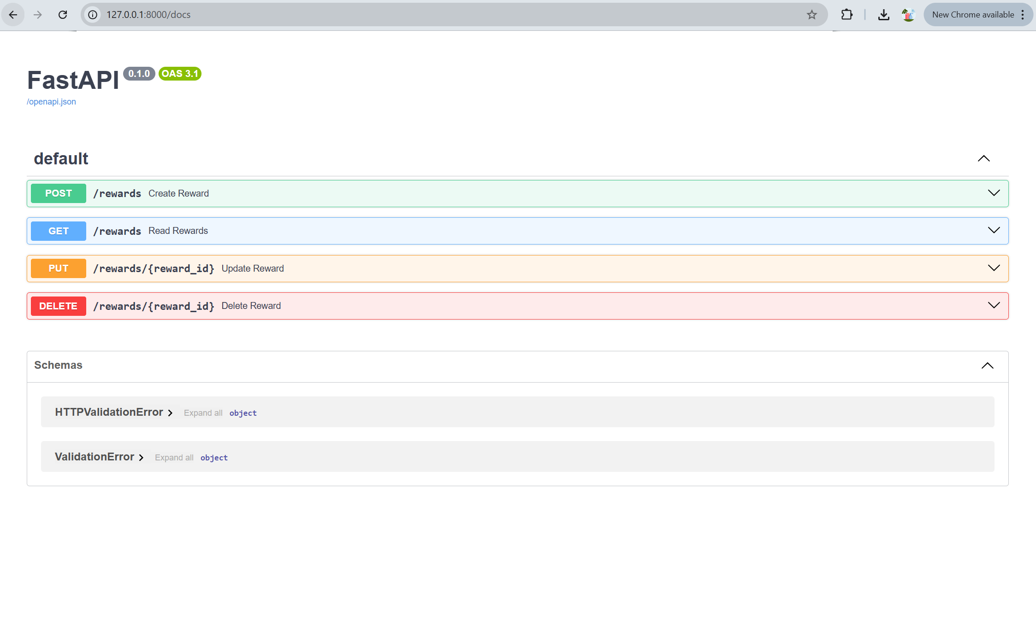

Slide 4
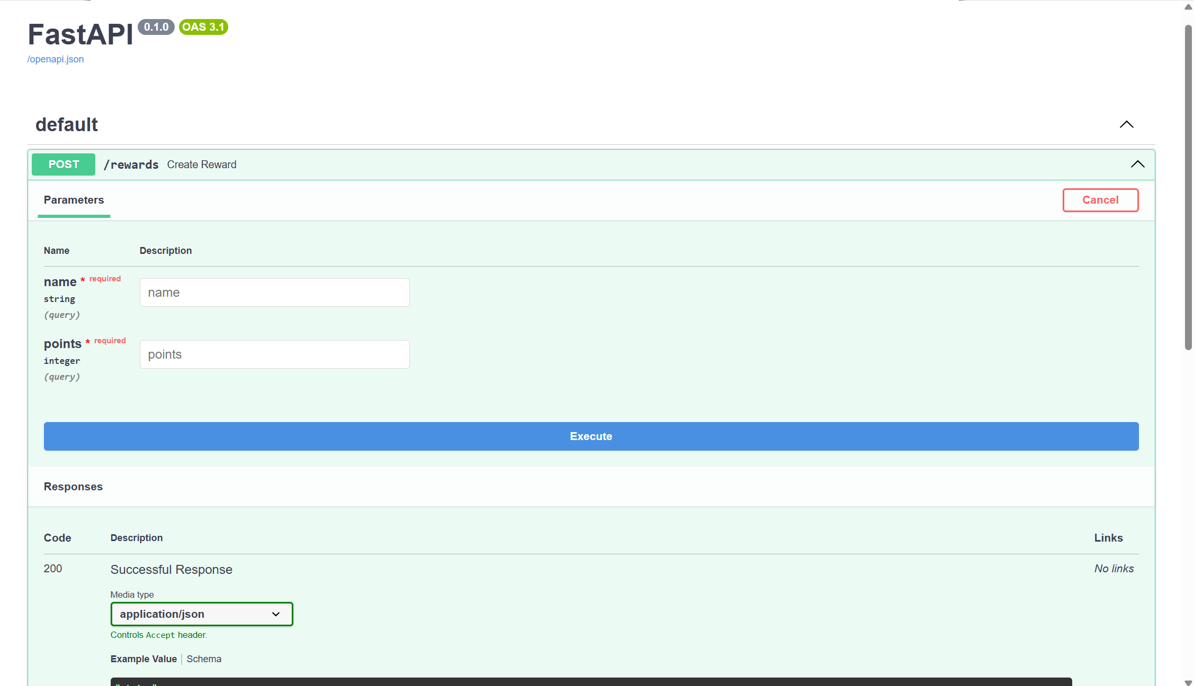

Slide 5

Future Outlook
Deployment and authentication.

